Slide 1

Industrial-grade version control
Beyond the
Commit
Architecting Scalable Workflows
with Git Flow
The Pulse of Production
Technical Deep Dive
Mastering Industrial Git & Workflow Patterns
2025

Slide 2
Foundation
Why "Industry Git" is Different
Auditability
Knowing who changed what and why. Every change is tracked, attributable, and documented for compliance and debugging.
01
The Problem
"It works on my machine" vs. "It broke the production server."
Automation
Integrating with CI/CD pipelines. Automated testing, building, and deployment eliminate manual errors and ensure consistent delivery.
02
Development Git workflows focus on convenience. Industrial Git workflows prioritize safety, accountability, and reliability at scale.
Scale
Handling 50+ developers on a single codebase without chaos. Coordinated workflows prevent conflicts and maintain stability.
03

Slide 3
Principles
The Golden Rules of Professional Git
01
Atomic Commits
03
Never Commit to Main
One logical change per commit. This makes it easier to revert specific changes without affecting other work.
Protecting the "Source of Truth". All changes go through review and testing before reaching production code.
✓ Single purpose ✓ Revertible ✓ Clear history
✓ Protected branch ✓ Enforced review ✓ Stable production
02
Meaningful Messages
04
Pull Requests (PRs)
Avoid vague messages like "fixed bug". Use structured format with context for better history and automated tooling.
The gateway for peer review and quality control. Enforces code review, automated checks, and discussion before integration.
Fix(Auth): Resolve timeout in login handler
"fixed bug"
✓ Code review ✓ Automated tests ✓ Quality gate
These rules transform Git from a simple VCS into a robust quality assurance system

Slide 4
Branching Model
Introduction to Git Flow
What is Git Flow?
Git Flow is a strict branching model designed around the project release. It provides a robust framework for managing large-scale development with multiple parallel workstreams, ensuring stability while enabling rapid feature development.
The Permanent Branches
The Support Branches
Always present, representing different stages of your codebase lifecycle.
Temporary branches for specific purposes, then deleted.
main
The Source of Truth
feature/*
New Stuff
Developing new features. Branch from develop, merge back via PR.
Production-ready code. Always stable, always deployable. Tagged with semantic versions.
release/*
Preparing Launch
Preparing for release. Stabilization, QA, minor bug fixes. No new features.
develop
The Bleeding Edge
hotfix/*
Quick Fixes
Integration branch for features. Continuous integration runs here. Latest delivered changes.
Critical fixes for production. Branch from main, merge to both main & develop.
Key Insight: Git Flow enables parallel development while maintaining production stability through strict branch isolation.

Slide 5
Governance
Branching Policy & Restrictions
Strict Rules to Maintain Sanity
Clear merge policies prevent chaos. Each branch type has strict merge targets to ensure code flows through the correct pipeline.
feature/*
develop
New features are integrated into the development branch for testing and aggregation.
bugfix/*
release/*
Bug fixes during stabilization are isolated to the release branch.
hotfix/*
main
+
develop
Critical fixes bypass normal flow to both production and development branches.
Prevents Leaks
Enforces Flow
Ensures Quality
Unstable code can't reach production accidentally.
Code follows a predictable path through the pipeline.
Each stage has appropriate gates and reviews.

Slide 6
Standardization
Conventional Commits - The API of History
The Problem
The Format
git log looking like:
():
• "wip"
• "fix"
feat
(auth):
add google oauth login
• "please work"
fix
(db):
resolve connection leak
The Solution
A structured format for commit messages that is machine-readable, enabling automated changelog generation, versioning, and release notes.
Common Types & Scopes
feat
= New feature
fix
= Bug fix
Critical for PRs: In this pipeline, PR Titles must follow this format because they become the final history (Squash & Merge).

Slide 7
Versioning
Semantic Versioning (SemVer)
Communicating Change through Numbers — A standardized way to communicate the nature of changes in your codebase.
Commit Type to Version Mapping
MAJOR.MINOR.PATCH
Type | Impact | Description
feat | MINOR 🚀 | New Feature
fix | PATCH 🐛 | Bug Fix
perf / revert | PATCH | Performance / Undo
BREAKING CHANGE | MAJOR 💥 | Breaking API (Footer)
docs / style / test | None | No Release Triggered
Example: 1.0.0
1
MAJOR (1.0.0)
Breaking changes — Incompatible API changes that require consumer updates
0
MINOR (1.1.0)
New features — Backwards compatible additions that don't break existing functionality
0
PATCH (1.0.1)
Automation: This mapping enables fully automated versioning — CI/CD systems can determine the next version automatically from commit messages.
Bug fixes — Backwards compatible fixes that resolve issues without changing APIs
Predictable
Automated
Consumers know when breaking changes occur
Tools can auto-version and generate changelogs
Clear contract between maintainers and consumers

Slide 8
Process
The Release Workflow
Not Every Push! — Releases are deliberate, not automatic
Question: "Do we release on every push to develop?"
Answer: NO.
develop is for Continuous Integration. Releases are deliberate events with proper stabilization phases.
01
Develop
Merge feature/* branches into develop. Automated tests run. Deploy to development environment for testing.
02
Freeze
Create release/v1.0.0 branch from develop. No new features — only bug fixes and stabilization.
03
Stabilize
Fix bugs with bugfix/* branches. QA testing, performance validation. Version bump in release branch.
04
Launch
Merge to main. Tag v1.0.0. Merge back to develop. Trigger release automation.
Key Insight: This workflow separates integration from release, giving you control over when and what gets deployed.

Slide 9
Automation
CI/CD Automation "What Now?"
The "What Now" Phase
What happens after we tag v1.0.0? The release handler workflow automates everything, eliminating manual errors and accelerating delivery.
Build Artifacts
Dockerize
Create executable binaries for Linux/Windows/Mac from the tagged release code.
Build and push Docker image to Registry with tag v1.0.0.
✓ Cross-platform builds ✓ Deterministic artifacts ✓ Optimized for production
✓ Immutable infrastructure ✓ Versioned containers ✓ Scalable deployment
Publish
Deploy
Create GitHub Release with automated changelog and downloadable binaries.
Update production cluster to pull image:v1.0.0.
✓ Auto-generated changelog ✓ Semantic version tags ✓ Public release artifacts
✓ Zero-downtime deployment ✓ Rollback capability ✓ Infrastructure as code
Result: From git tag to production in minutes, with full traceability and zero manual intervention.

Slide 10
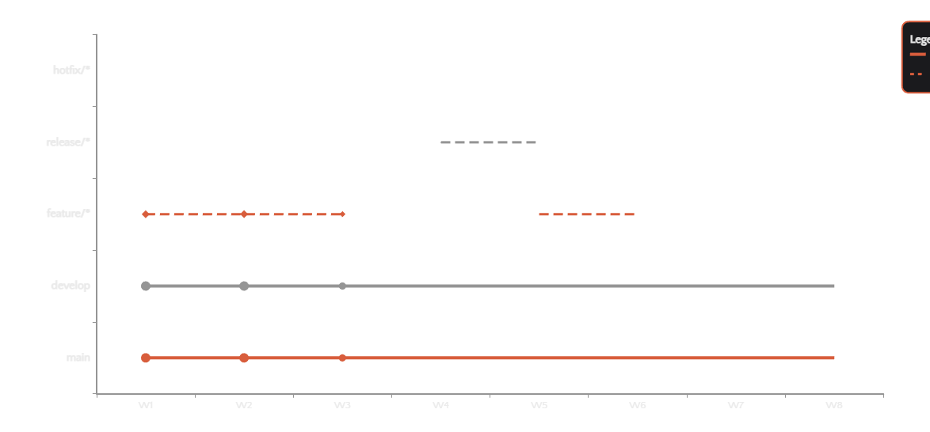
System Architecture
Complete Git Flow Architecture

Slide 11
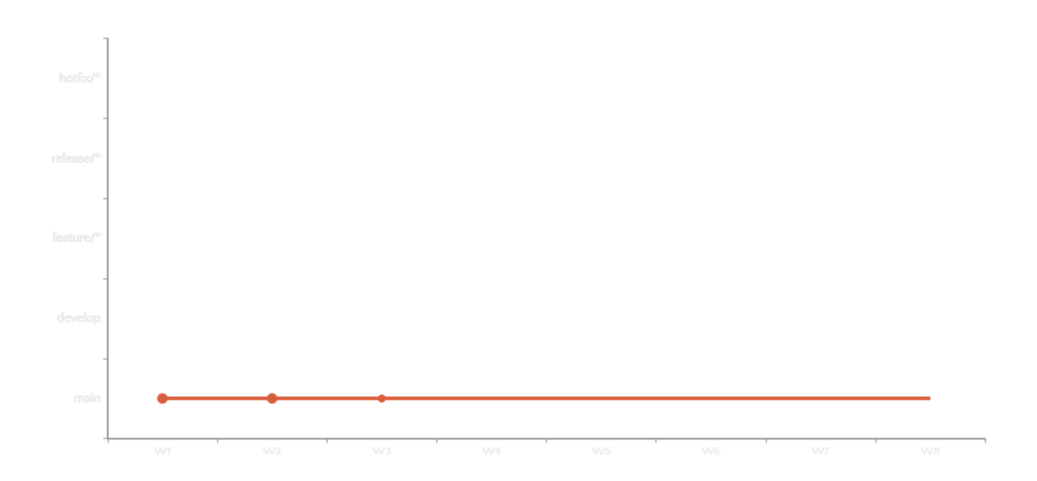
System Architecture
Complete Git Flow Architecture

Slide 12
The Fully Automated Release Machine
Git Flow
+
Conventional Commits
+
SemVer
Branching Strategy
Message Standard
Versioning Scheme
=
Fully Automated, Reliable Releases
Automation allows us to focus on Code, not Choreography
Let's adopt these checks today!
Transform your development workflow into a production-ready machine
The Pulse of Production
Thank you
Mastering Industrial Git & Workflow Patterns
Questions & Discussion

